Slide 1
Financial analytics
Prashant Kunal

Slide 2
CONTENTS
Introduction
Data Exploration
Portfolio Build Up
Summary

Slide 3
INTRODUCTION
In a dynamic business landscape, staying informed about market trends and competitor performances is crucial. This project dives into the financial metrics of the top 500 companies in India, aiming to provide valuable insights for investors and business leaders. The analysis encompasses market capitalization, sales performance, sector-wise trends, correlations, risks, and competitor benchmarking.

Slide 4
Data exploration
The dataset contains information on the market capitalization and sales performance of the top 500 Indian companies. Preliminary data exploration involves understanding the dataset structure, identifying key variables, and addressing any initial challenges. The focus is on preparing the data for in-depth analyses, ensuring a solid foundation for deriving meaningful insights.

Slide 5
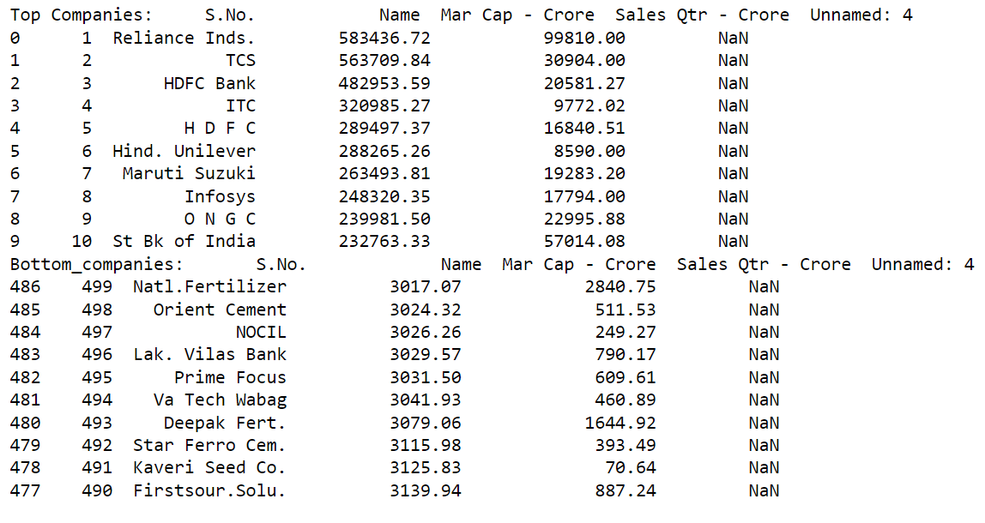
Market capitalization analysis
Top and Bottom Companies based on Market Capitalization:
Identified the top companies with the highest market capitalization and the bottom companies with the lowest market capitalization.

Slide 6
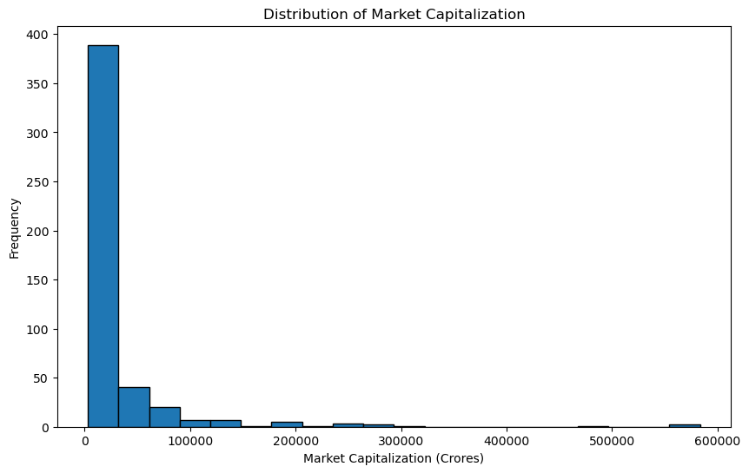
Distribution analysis
Distribution Analysis of Market Capitalization:
Visualized the distribution of market capitalization across all companies using a histogram, providing insights into the spread of values.

Slide 7
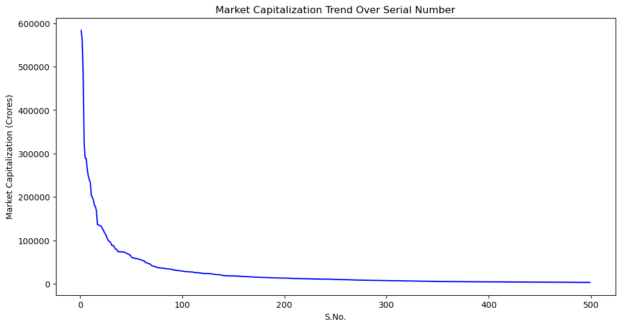
Trend analysis
Trend Analysis of Market Capitalization:
Plotted the trend of market capitalization over the serial number, offering insights into overall market capitalization growth or decline.

Slide 8
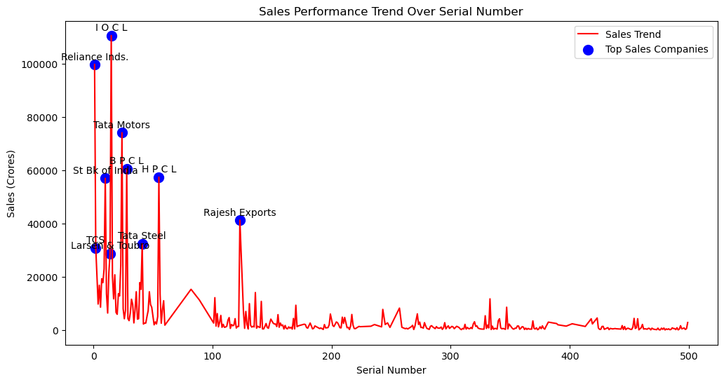
Sales performance analysis

Slide 9
Sales Performance Analysis
The sales performance analysis focused on understanding the correlation between market capitalization and quarterly sales of the top 500 companies in India. After data cleaning to address specific challenges in sales data, visualizations were employed to showcase trends in sales performance. The analysis revealed notable correlations between market capitalization and sales, offering insights into the financial dynamics of these companies. This understanding sets the stage for strategic decision-making, providing stakeholders with valuable information for investment and growth strategies.

Slide 10
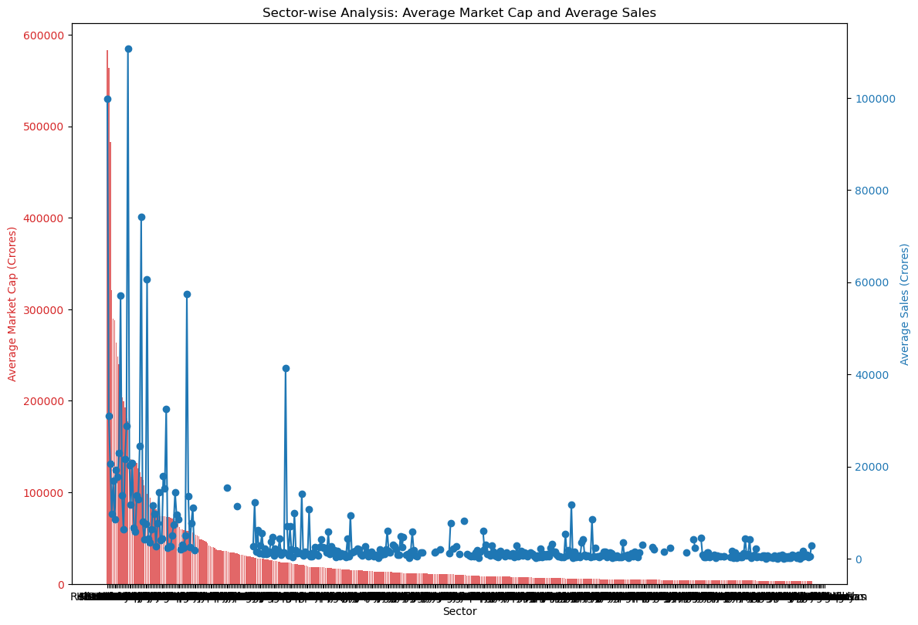
Sector-wise Analysis:
The sector-wise analysis delved into the distribution of top 500 companies across different industries, providing insights into sector-specific trends. Visualizations highlighted the market capitalization and sales performance variations among sectors. Notable patterns and challenges within specific industries were identified, offering a nuanced understanding of the market landscape. This sector-wise perspective equips stakeholders with targeted insights for industry-specific strategies and decision-making.

Slide 11
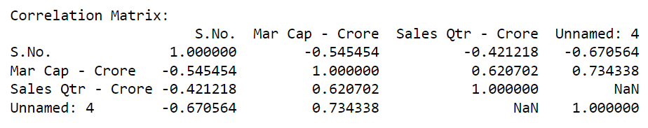
Correlation Analysis
Correlation Matrix:
Calculated the correlation matrix to understand the relationships between different variables, including market capitalization and sales performance.
Examined the strength and direction of correlations, ranging from -1 to 1.
Heatmap Visualization:
Visualized the correlation matrix using a heatmap for a clearer representation of correlations.
The heatmap provides an intuitive view of the relationships, with color intensity indicating the strength and direction of correlations.
Insights:
Identified significant correlations between attributes, enabling a deeper understanding of how variables such as market capitalization and sales are interrelated.
This analysis assists in recognizing potential factors influencing company performance and supports informed decision-making for the management.

Slide 12
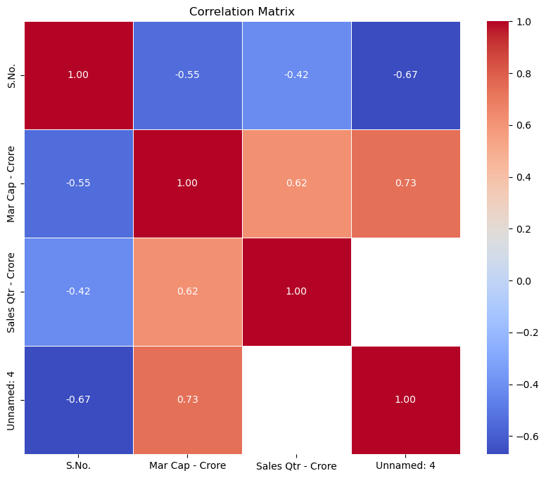

Slide 13
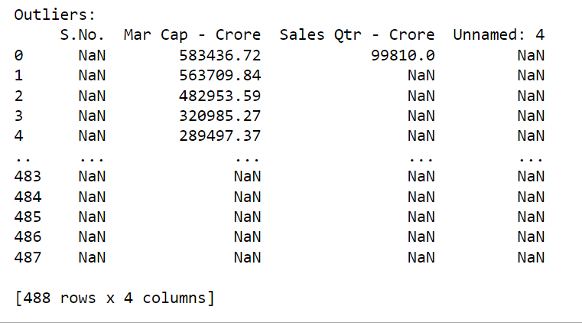
Identify Outliers:
The identification of outliers involved robust methods to pinpoint companies with exceptional market capitalization or sales performance. Visualizations were employed to showcase these outliers and their potential impact on the overall analysis. This step allows for a focused examination of high-performing or underperforming companies, enabling stakeholders to investigate further and gain insights into unique success or risk factors within the top 500 companies in India.

Slide 14
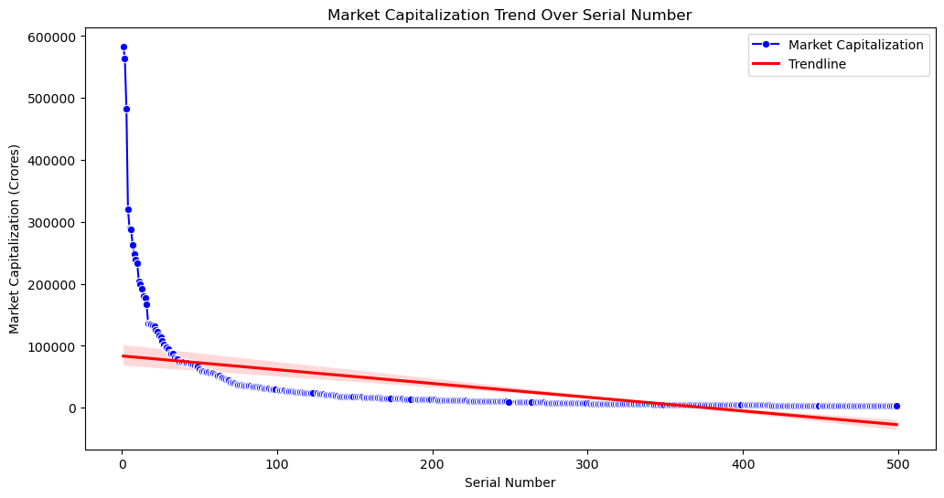
Trends And Pattern Analysis:
The trends and pattern analysis uncovered significant market movements and financial patterns within the dataset. By identifying and interpreting these trends, valuable insights were gained into the dynamic behavior of the top 500 companies in India. The analysis serves as a foundation for strategic planning, offering stakeholders a forward-looking perspective to adapt and capitalize on emerging patterns in the market landscape.

Slide 15
Competitor Benchmarking Analysis
In the Competitor Benchmarking analysis, the top 5 companies were meticulously compared against the rest within the dataset. Key performance metrics were defined for comparison, and visualizations provided a clear overview of how these top performers measure against their counterparts. This analysis equips stakeholders with valuable insights into competitive positioning, allowing for strategic decision-making and performance evaluation within the broader market context.

Slide 16
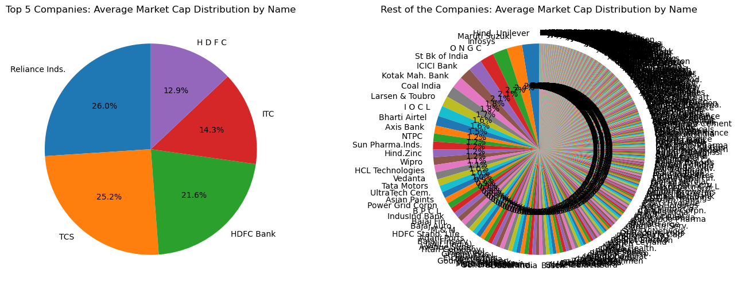

Slide 17
Risk Analysis:
The risk analysis focused on assessing financial risks within the market capitalization and sales performance of the top 500 companies in India. Key metrics, including standard deviation and coefficient of variation, were utilized to quantify the level of risk associated with these financial indicators. This analysis provides stakeholders with a concrete understanding of the volatility and variability in the financial metrics, enabling them to formulate proactive strategies to mitigate potential risks. By identifying and addressing these risks, stakeholders can enhance their decision-making processes and navigate the market dynamics more effectively. The insights gained contribute to a more robust risk management approach, ensuring a resilient and adaptive stance in the face of uncertainties.

Slide 18
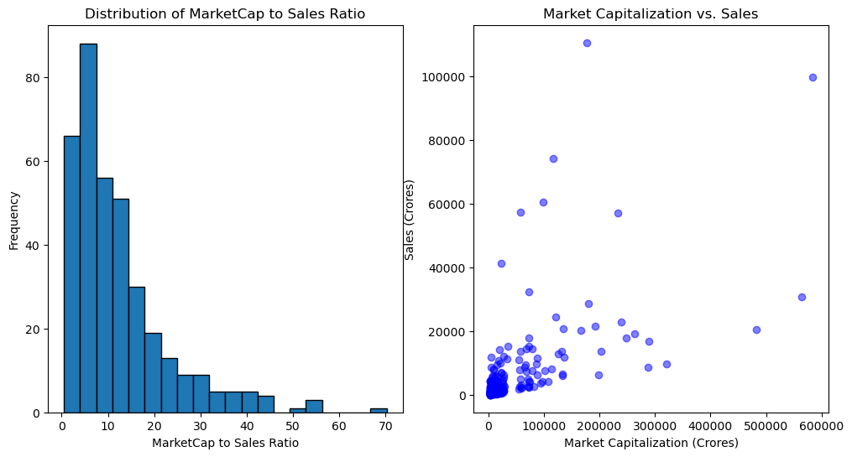

Slide 19
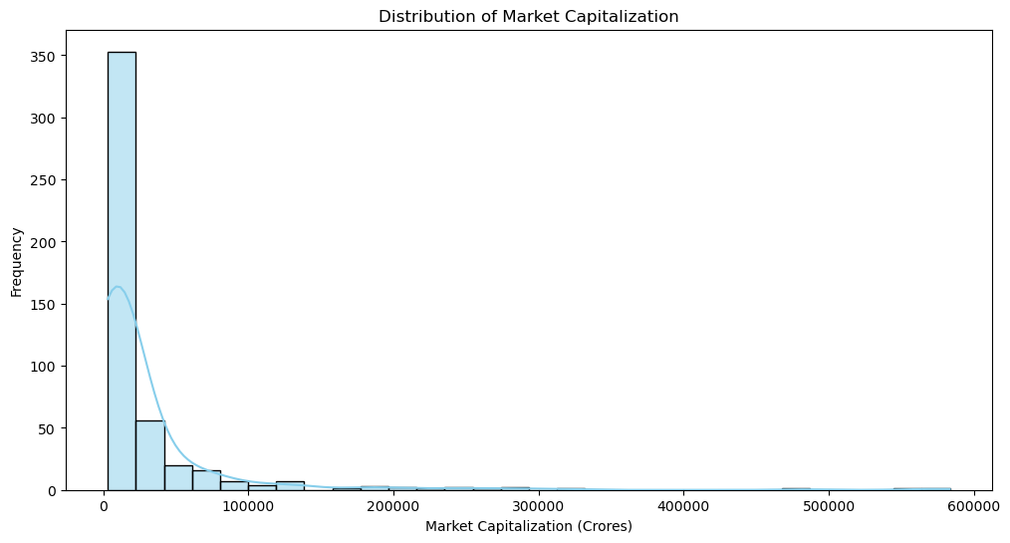
Visualisation:

Slide 20
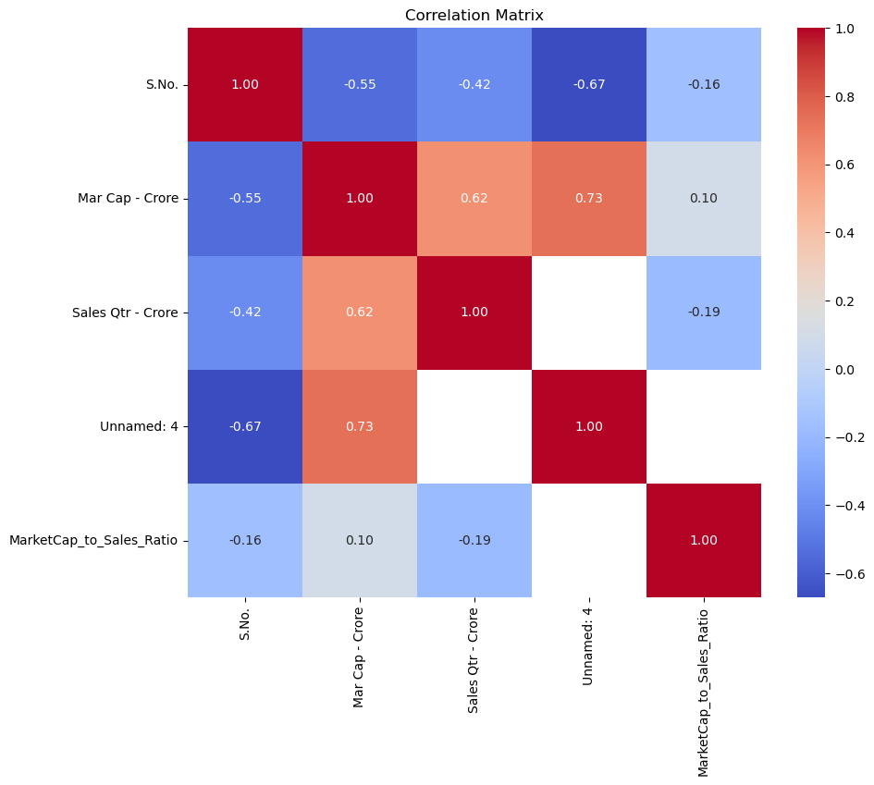

Slide 21
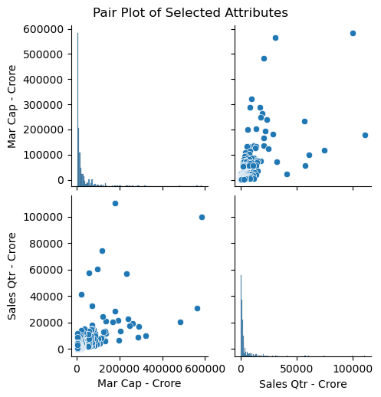

Slide 22
Utilizing Python libraries such as matplotlib and seaborn, diverse visualizations were employed to enhance the understanding of the top 500 companies' dataset. A histogram illuminated the distribution of Market Capitalization, providing insights into the dataset's central tendencies. A correlation matrix heatmap depicted relationships between key attributes, offering a comprehensive view of interdependencies. The pair plot allowed for a simultaneous exploration of selected attributes' relationships. Finally, a boxplot by sector showcased the distribution of Market Capitalization, aiding in the identification of sector-specific trends. These visualizations collectively served to illuminate patterns, correlations, and sector-specific dynamics, facilitating informed decision-making for stakeholders.

Slide 23
Summary:
The comprehensive analysis of the top 500 companies in India revealed significant insights into their financial dynamics. Key aspects, including market capitalization, sales performance, sector-wise trends, correlations, outliers, and competitor benchmarking, were thoroughly explored.
Visualizations, such as histograms, correlation matrices, pair plots, and boxplots, provided a clear and nuanced view of the dataset. These visual insights facilitated the identification of patterns, correlations, and sector-specific behaviors, essential for strategic decision-making.
The risk analysis quantified financial uncertainties, while competitor benchmarking offered a comparative perspective on top-performing companies. Outlier identification pinpointed exceptional performances, guiding further investigation.
In summary, this analysis equips stakeholders with actionable information for investment decisions, risk management, and strategic planning. The combination of robust data analysis and effective visualization techniques enhances the understanding of the Indian business landscape, empowering stakeholders to navigate and thrive in a dynamic market environment.

Slide 24
THANK YOU

